Slide 1






Slide 2

MCCA
“You’ve Got This” Marketing Campaign
Pamela Cox-Otto, Ph.D. - Interact Communications
July 31, 2014

Slide 3
Fall Marketing
The Plan
Spring 2014 - Interact developed a marketing plan, media plan, materials list, content and design
In May 2014, Interact worked with individual colleges to buy and place media with statewide outlets
Design, develop & migrate a “You’ve Got This” website
Interact began providing monthly analytic reports to the MCCA based on web hits, reach and impression

Slide 4
Fall Marketing
The Changed Plan
Rather than a state focus the campaign was developed around a college focus
Interact developed media buys in concert with marketing managers from each participating college
Interact’s Media Buyer modified the media mix in to best match each college’s media market
Media was purchased to mirror college contributions

Slide 5

“You’ve Got This”

Slide 6
Fall 2014 Marketing Campaign
Developed a plan consisting of 50+ individual and customized marketing materials to run with statewide media outlets.
Designed and uploaded: April 2014
http://clients.interactcom.com/mcca/brand/
Placed with media outlets: May-August, 2014
Included varied media: billboards, emails, postcards, digital ads, banners, newspaper ads, radio spots, TV spots
Branded with “You’ve Got This” to not only impact enrollment, but to create stickiness with the new brand.

Slide 7
Fall 2014 Marketing Campaign
TV Ads:
http://www.youtube.com/watch?v=_UKgh_lBrJ8&rel=0
http://www.youtube.com/watch?v=02pHf-rVDmo&rel=0
Radio Ads:
http://clients.interactcom.com/mcca/brand/audio/MCCA/Radio1
http://clients.interactcom.com/mcca/brand/audio/MCCA/Radio2

Slide 8
Fall 2014 Marketing Campaign
Cable, Billboard, Radio, Newspaper, Digital Analytics
May 16 – July 15, 2014:
585 million impressions
91-97% average reach (variances by market depending upon media selection by choice of individual colleges)
6-8 average frequency (slight variances by market depending upon media selected)
11,762 total clicks (Facebook, Google AdWords and YouTube)
384 free/no charge ads on cable (autofill)

Slide 9
Digital Ads: Facebook and Google AdWords
Impressions and Reach
Facebook and Google Adwords: May 16 – July 15, 2014
Total Clicks: 11,762 (Facebook, Google, YouTube)
Total Impressions: 26,178,123

Slide 10
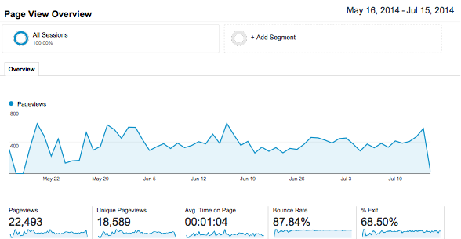
Web Analytics - Traffic to Campaign Home Page
This image shows the weekly traffic to the home page
22,493 page views to the campaign homepage:www.youvegotthis.org between May 16 – July 15, 2014

Slide 11
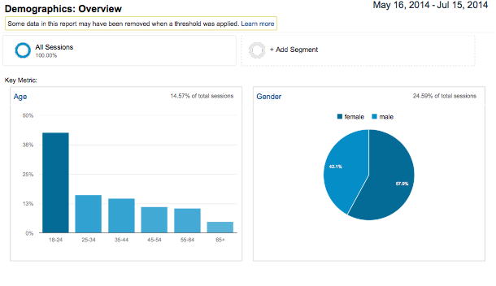
Web Analytics - Site Visitor Demographics
More than 40% of all users are between the ages of 18-24

Slide 12

Web Analytics - Visitor Flow from Home Page
60% of all home page visitors watch the campaign video

Slide 13
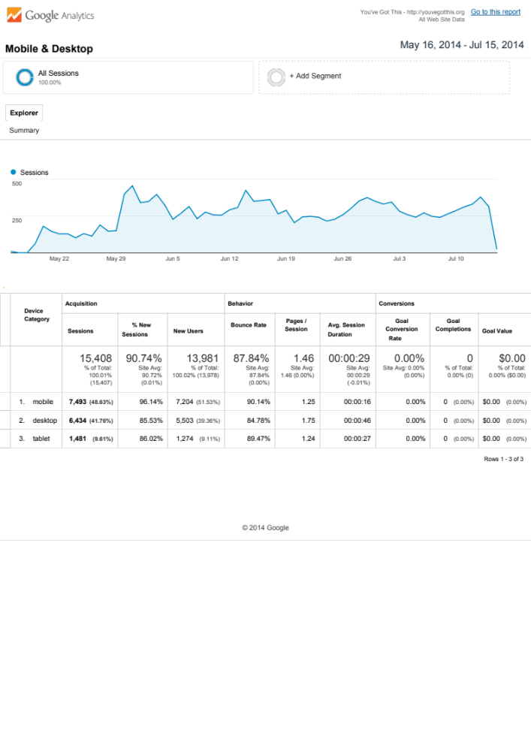
Web Analytics - Desktop vs. Mobile Traffic
Mobile and Tablet use combined are approaching 60% of all the web traffic

Slide 14
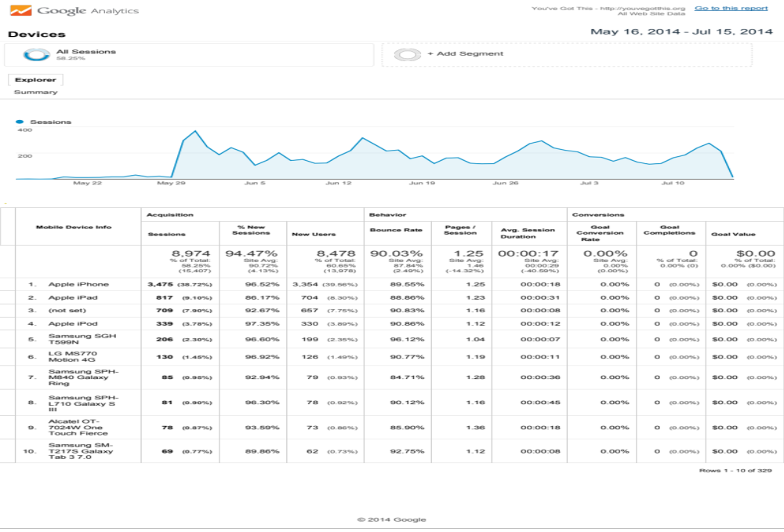
Web Analytics - Devices used to access the Website
An analysis of the mobile devices used to access the the website.
50% Apple, 43% Android 7% for Windows, Blackberry and all others combined.

Slide 15
Next Steps
Implementation of Promotion and PR elements this Fall
Implement shared collateral creation
Decision to Continue and Budget
A Marketing/Media Plan for Fall and Spring 2015
An intermediate media buy to keep digital components of the campaign live
Phase Two of On-Site Filming for Extended TV ads
Function and usability updates to the website:
  Adding more Home Page videos (60% played video)
  Adding Program Videos to program section
  Adding Career Paths, descriptions and alumni testimonials
  Integrated social media & expanded tracking

Slide 16




interactcom.com youtube.com/interactcom facebook.com/interactcom twitter.com/interact

